Slide 1

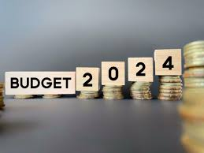
Managerial Economics
News Analysis On Budget 2024
Ashwin Dhumal
Bill Gates Batch

Slide 2

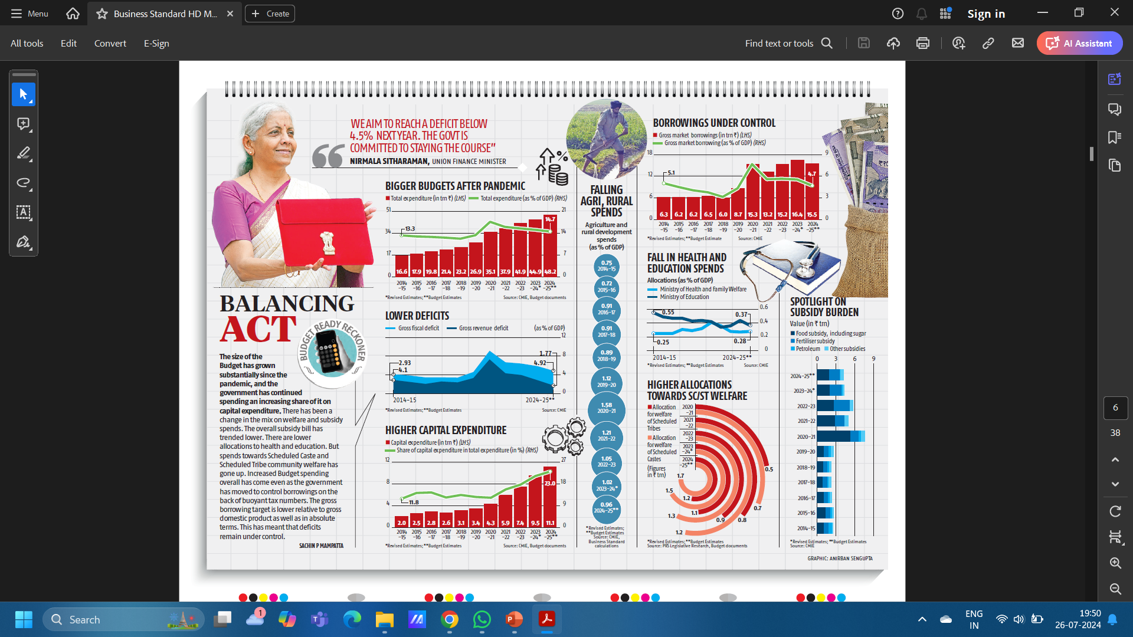
News Article from Business Standard Newspaper dated 24/07/2024.

Slide 3
The above article provides a thorough summary of the budgetary and fiscal policy adjustments made by the Indian government in recent years, particularly considering the pandemic and its aftermath.
Gross Market Borrowings: The government plans to stabilize fiscal parameters in order to keep the deficit below 4.5% in spite of higher borrowing.
Total Expenditure: In absolute terms, total expenditures has increased due to increased government spending. On the other hand, expressed as a percentage of GDP, it suggests a regulated and balanced growth strategy.
Deficits: Although it has varied, the gross budget deficit as a proportion of GDP has been declining recently.
The article suggests that attempts to manage and lower the deficit are still ongoing. Additionally, the gross revenue deficit has been tightly controlled, a downward trend suggests budgetary discipline. The Indian government has been very careful to strike a balance between growing capital investment, reducing subsidies, and managing deficits, as the article illustrates.

Slide 4

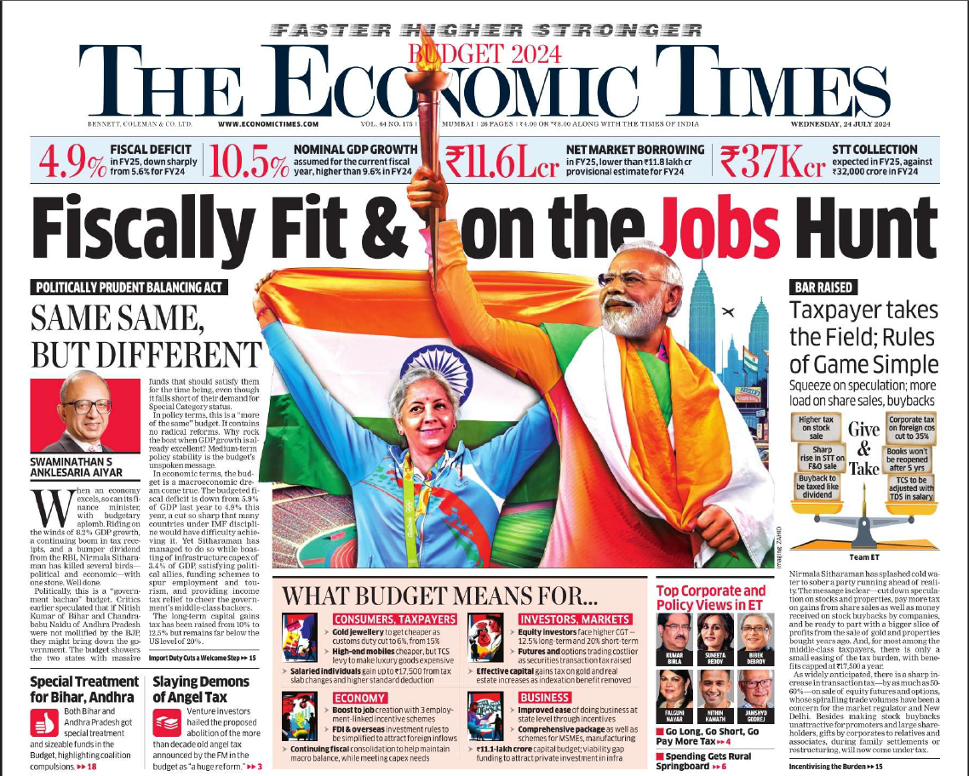
News Article from
The Economic Times Newspaper dated 24/07/2024.

Slide 5
The above article offers commentary on the FY 2024 Indian budget and offers insights into the fiscal policies, budgetary allotments, and economic tactics of the administration.
Current Situation: Estimates for FY2025's fiscal deficit indicate a sharp decline from FY2024's 5.6% to 4.9%.
Projection: Forecasted nominal GDP growth for FY25 is 10.5%, up from FY24's 9.6%. Compared to the first projection of ₹11.8 lakh crore for FY24, net market borrowing is predicted to be ₹11.6 lakh crore in FY25.
Forecast: Compared to ₹32,000 crore in FY24, STT collection is expected to reach ₹37,000 crore in FY25. Raising taxes on speculative transactions, such as futures and options, and significantly raising the STT demonstrate a desire to reduce excessive speculation and raise money.

Slide 6
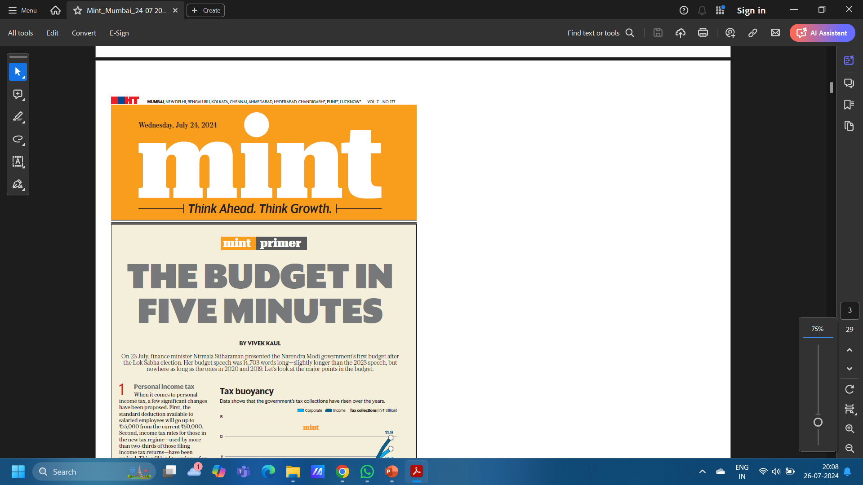
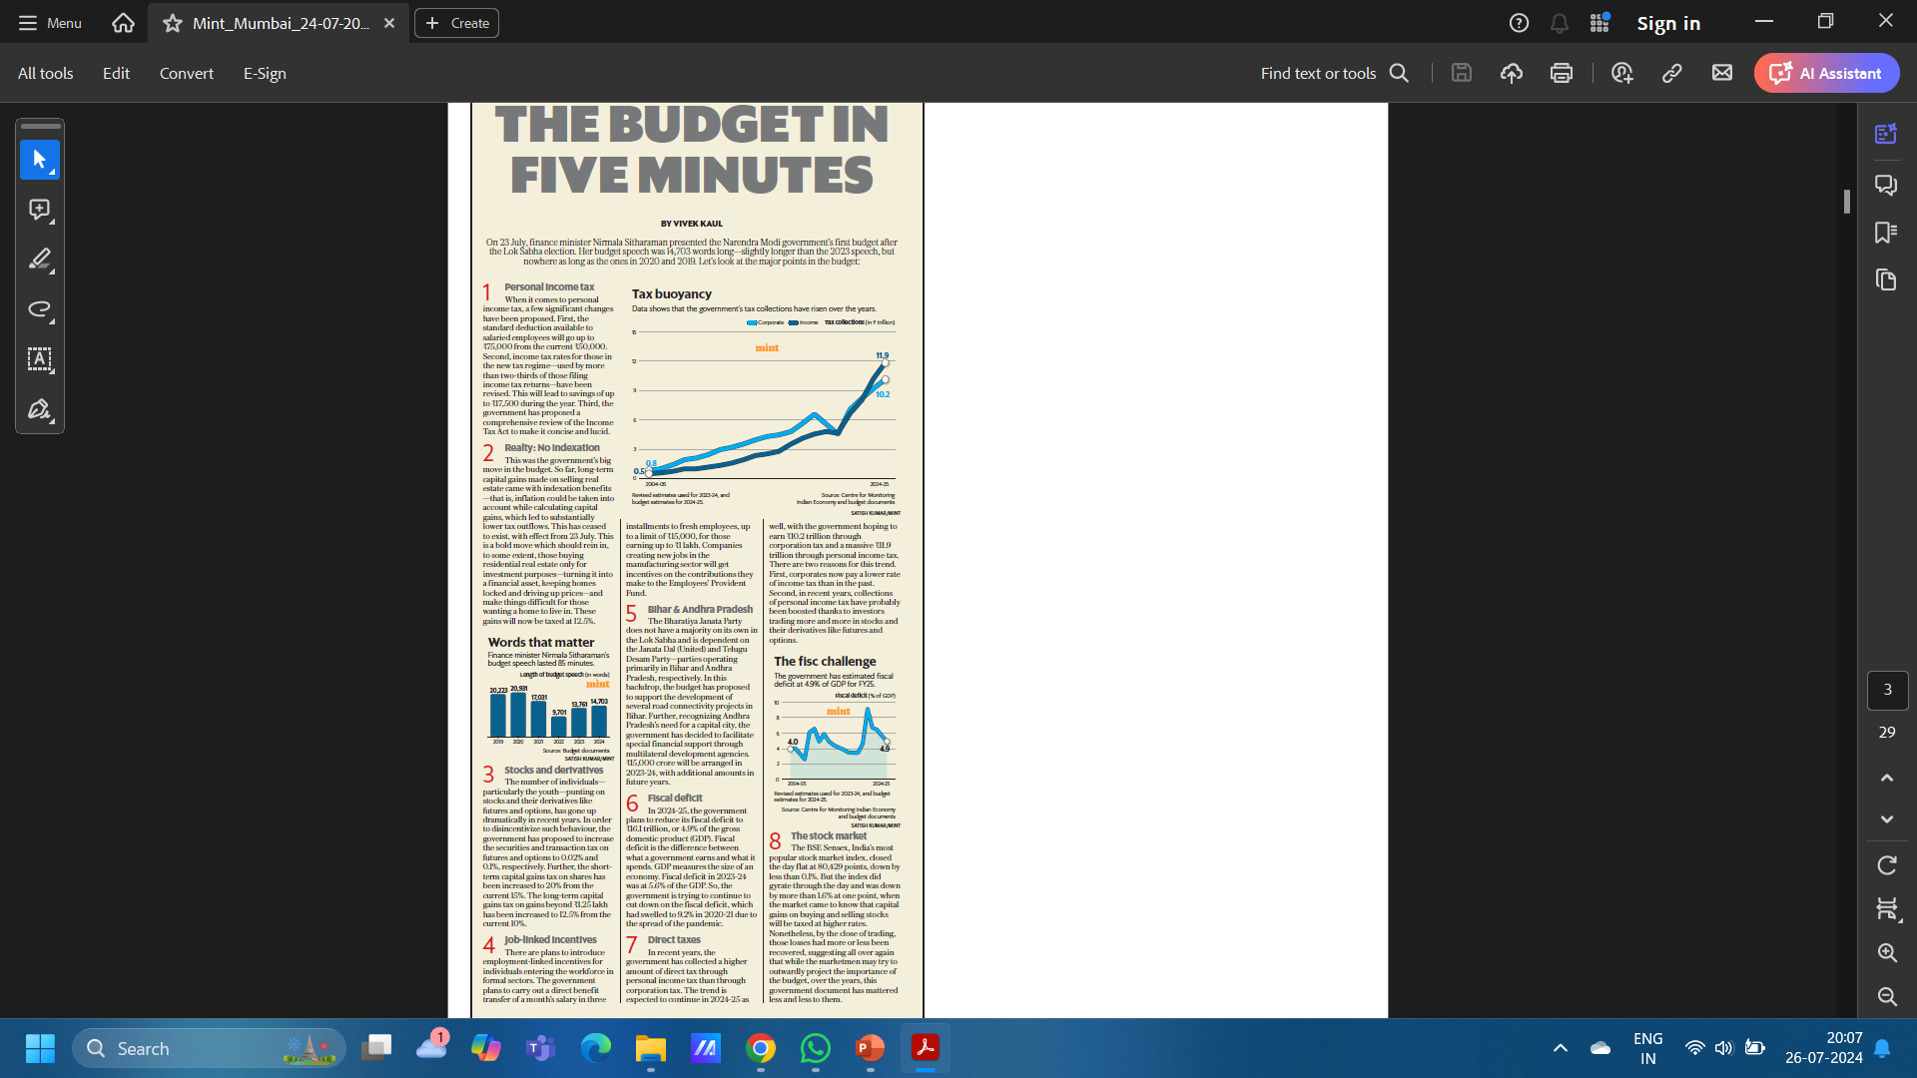
News Article from
Mint Newspaper dated 24/07/2024.

Slide 7

The main ideas from Finance Minister Nirmala Sitharaman's July 23 budget address are outlined in the article by Vivek Kaul. Changes in fiscal management, tax policy, and regional allocations are the main topics of discussion.
Tax Act Review: The government suggests a thorough overhaul of the Income Tax Act in order to make it easier to read and comprehend, which may facilitate the administration and compliance of taxes.
Removal of Indexation Benefits: Indexation advantages, which corrected gains for inflation, were previously included in long-term capital gains on real estate. Now that this benefit has been eliminated, gains are subject to a 12.5% tax. This reform attempts to lower housing costs for actual home buyers by focusing on speculative real estate investments.
Special Allocations: The budget shows the political approach to placate important coalition partners and assist regional development, with considerable sums allocated for road connectivity projects in Bihar and specific financial support for Andhra Pradesh.

Slide 8

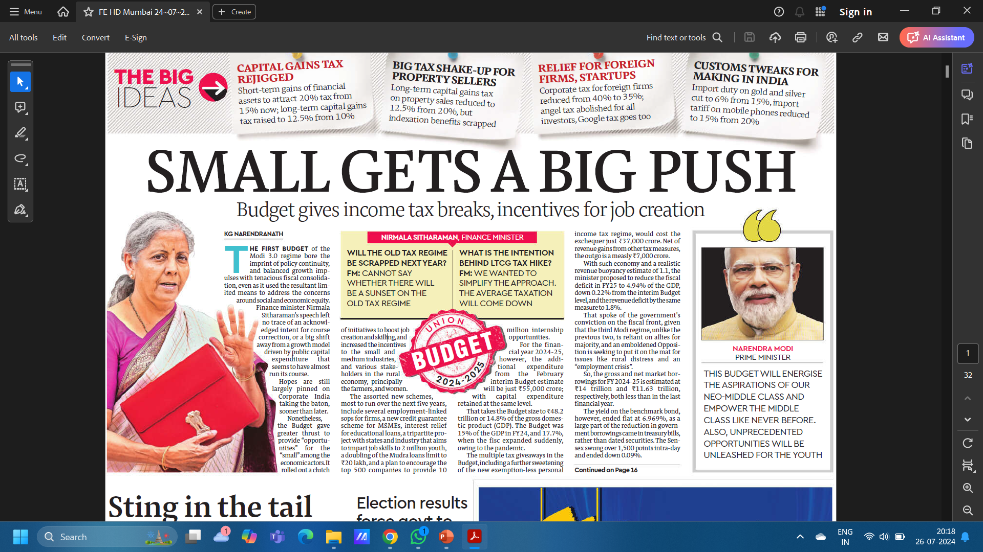
News Article from
Financial Express Newspaper dated 24/07/2024.

Slide 9
The main points of the first budget of the Modi 3.0 government, which Finance Minister Nirmala Sitharaman oversaw, are examined in this essay by KG Narendranath. The emphasis is on how the budget promotes social justice, job growth, and small and medium-sized businesses (SMEs) while maintaining fiscal restraint.
Incentives for SMEs: New programs are unveiled to assist small and medium-sized businesses. This includes programs to increase job creation and skill development as well as a credit guarantee program.
Bond Yields and Stock Market: Treasury bills were more negatively impacted by the decrease in government borrowing than longer-dated securities, since the yield on benchmark bonds was unchanged at 6.969%. The BSE Sensex fluctuated 1,500 points during the day before closing marginally lower by 0.09%, demonstrating the volatility of the stock market. This illustrates the differing opinions of investors regarding the budgetary measures.
Social Equity: In line with the government's larger socioeconomic objectives, the budget seeks to enhance social and economic justice by giving targeted assistance to youth, rural communities, and the neo-middle class.

Slide 10

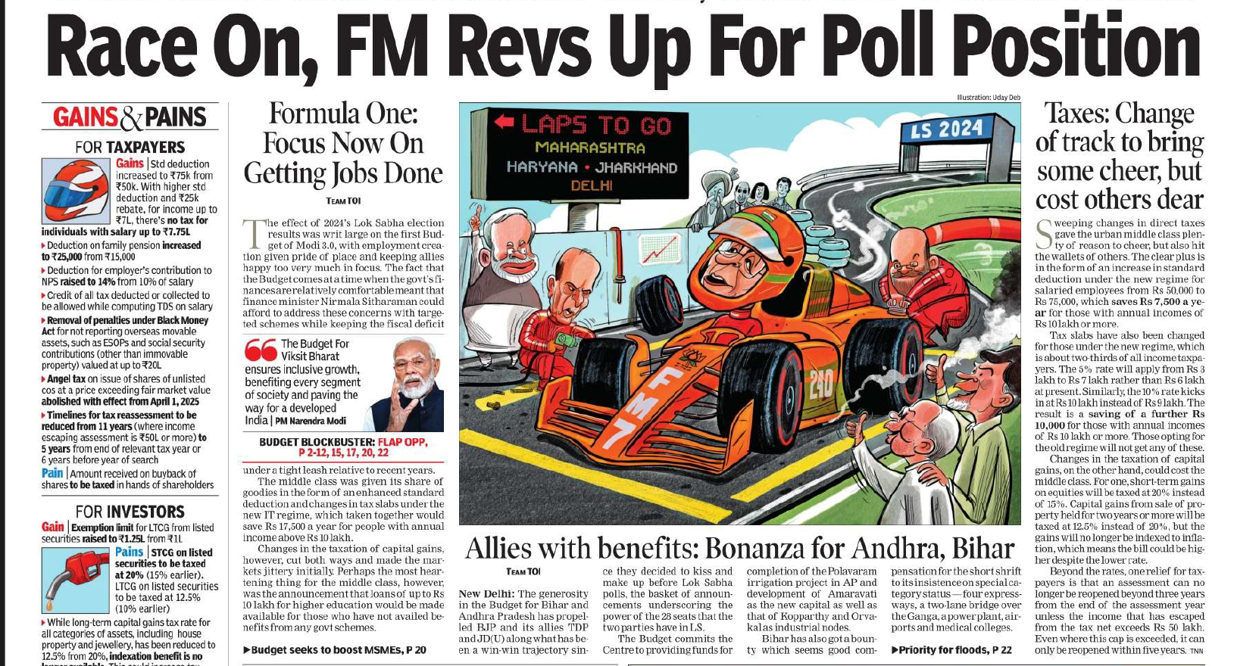
News Article from
The Times Of India Newspaper dated 24/07/2024.

Slide 11
The finance minister Nirmala Sitharaman's 2024 budget is summarized in the article "Race On, FM Revs Up For Poll Position," along with its main points and ramifications.
Increased Standard Deduction: For salaried workers, the standard deduction has increased to ₹75,000 from ₹50,000. With this modification, individuals earning more than ₹10 lakh can benefit from an extra ₹7,500 in tax savings.
Revised Income Tax Slabs: The income band rates under the new tax regime have been lowered. For example, the 10% tax rate begins at ₹10 lakh (formerly ₹9 lakh), and the 5% tax rate now runs from ₹3 lakh to ₹7 lakh (up from ₹6 lakh). For people whose salaries exceed ₹10 lakh a year, this modification might result in savings of up to ₹17,500.
Job Creation: The budget prioritizes creating jobs through a number of initiatives. This includes plans to offer 10 million internships, a new credit guarantee program for MSMEs, and higher Mudra loan ceilings.
Higher Education Loans: In order to finance higher education, loans up to ₹10 lakh would be granted to individuals who have not previously benefited from government initiatives.

Slide 12
THANK YOU

